Slide 1
Using Reinforcement Learning and Algorithmic Techniques to Develop Strategies for Tournament-Style Backgammon Matches
Will Farmer
Computer Science (Level 3)
9/12/2024

Slide 2
Motivation
All popular backgammon algorithms focus on winning individual games
Backgammon is played in a first-to format, where the victor is the first player to reach the score limit
You can strategize for a better point return by using the Doubling Cube, or aiming to win by gammon or backgammon, which yield additional points

Slide 3
Motivation
Tesauro’s TD-Gammon is almost 20 years old and is still the leading Backgammon AI
A reinforcement learning model focused on winning individual games
Uses heuristic doubling algorithm
Model didn’t include information about backgammons
Is it possible to make a model that performs better in tournament-style matches?

Slide 4

Deliverables
Basic
Random Agent
Robust Game Environment
Graphical User Interface (GUI)
Intermediate
Greedy Agent
Genetic Agent
Ant Colony Agent
Advanced
Reinforcement Learning Agent
Machine Learning Agent
Agent that changes strategy based on state of the game

Slide 5
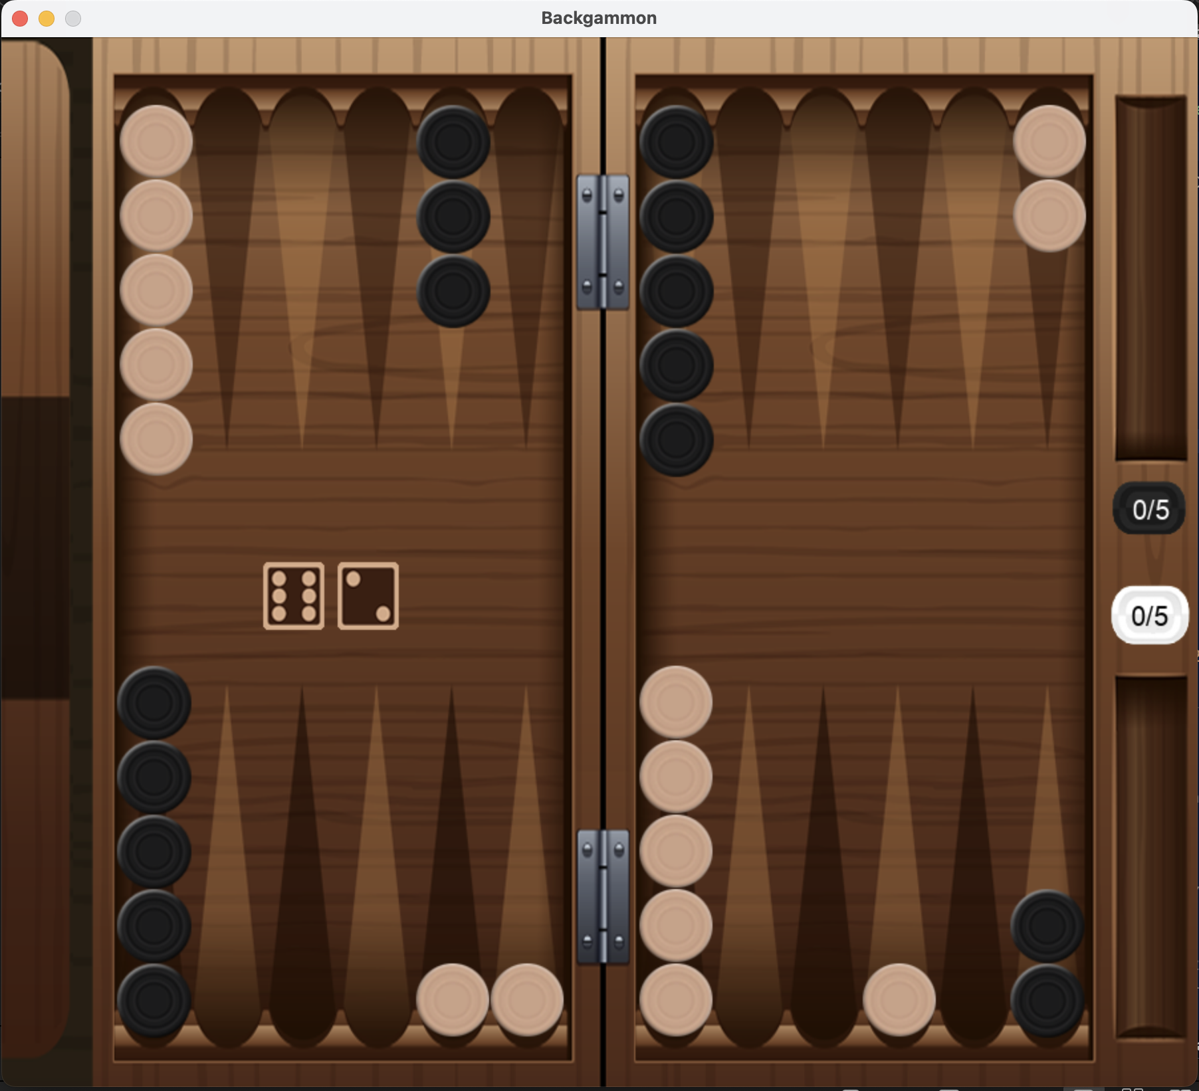
Approach Tools and Tech
Pygame
For the GUI
PyTorch
For training my advanced models
Level 2 AI Search
To support the development of my intermediate agents
PubEval
To test against TD-Gammon

Slide 6
What data am I collecting and why?
Scores and winners of hundreds of games
Each move the agents make, the dice roll, and the board state before and after each move
How many time steps are in each game

Slide 7
Why am I collecting this data?
Checking that agents are performing as expected
E.g. greedy agent is consistently and convincingly beating random agent
I check that the board is always being updated correctly and that the moves being made are legal and line up with what dice were rolled
This also allows me to check retrospectively that the greedy agent is making the intended move
The number of time steps in a game is a strong indicator as to how much game information has been given to the agent
Tesauro’s biggest issue training TD-Gammon at the start was that games were taking too long, putting a vast drain on resources

Slide 8
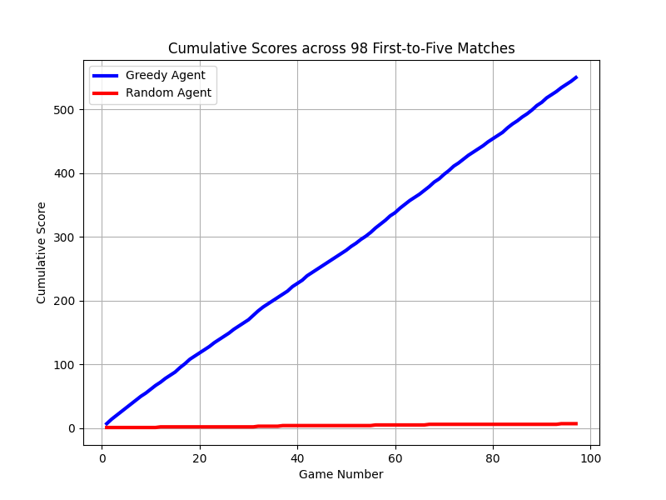
How will I measure success?
Each agent will play against each other, as well as TD-Gammon hundreds of times in the world championships format. They will also play human participants.
I will record win percentages and average point differentials to determine success
First target is to have an average point differential ≥ -0.66 per game
Second target is for average point differential ≥ -0.4 per game
Third target is for average point differential ≥ -0.25 per game

